Slide 1
Multi-Chat Program
컴퓨터 네트워크 실습
2019.05.24
이상우
sam_2011@hallym.ac.kr

Slide 2
Index
Multi-Chat Program

Slide 3
Multi-Chat Program
다중 채팅 서버 코드 구성
ChatClient.java, ReceiveDataThread.java, ChatServer.java , ChatServerThread.java
ChatClient
ChatServer
HashMap
While{
//콘솔에 입력되는 텍스트 전송
}
Output
Stream
Id1, OutputStream1
Id2, OutputStream2
Socket
ReceiveDataThread
ChatServerThread는 수신한 데이터를 HashMap을 이용해서 Broadcast
Input
Stream
ChatServerThread
ChatServerThread
서버로부터 수신되는 Text 출력

Slide 4
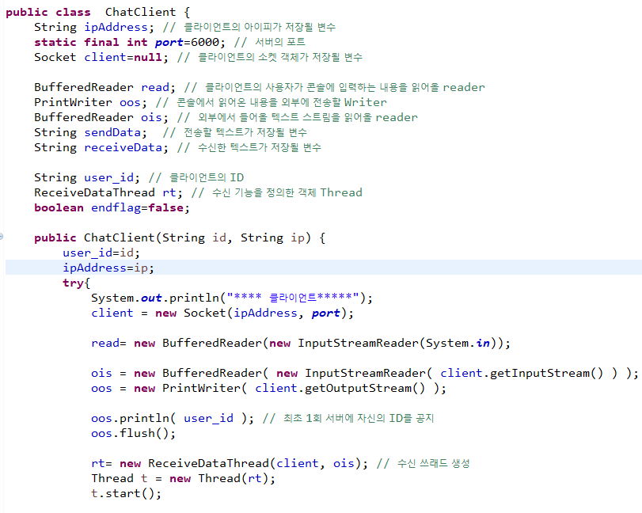
Multi-Chat Program
Client

Slide 5
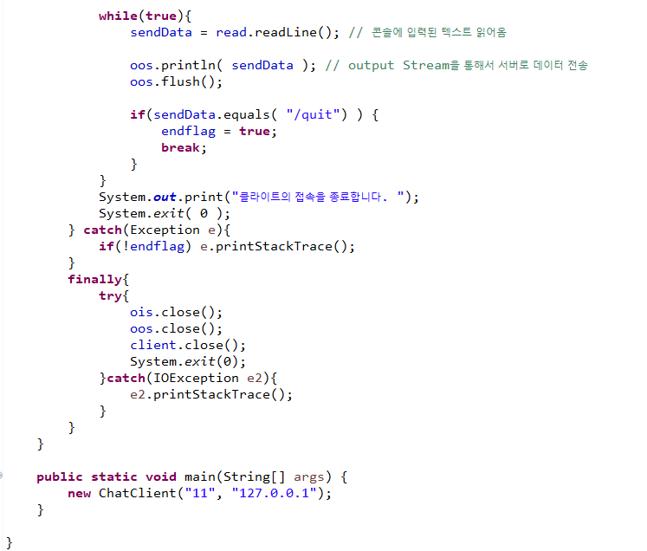
Multi-Chat Program
Client

Slide 6
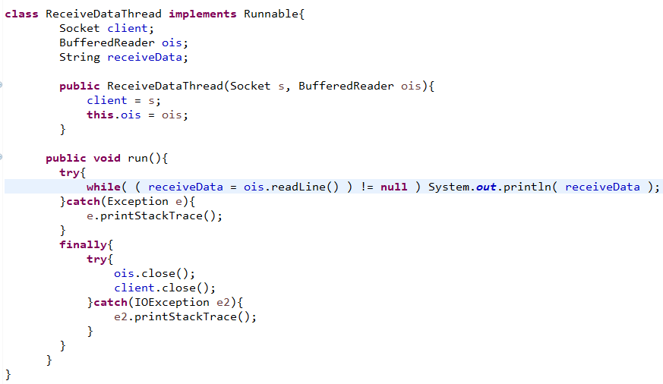
Multi-Chat Program
ReceiveDataThread

Slide 7
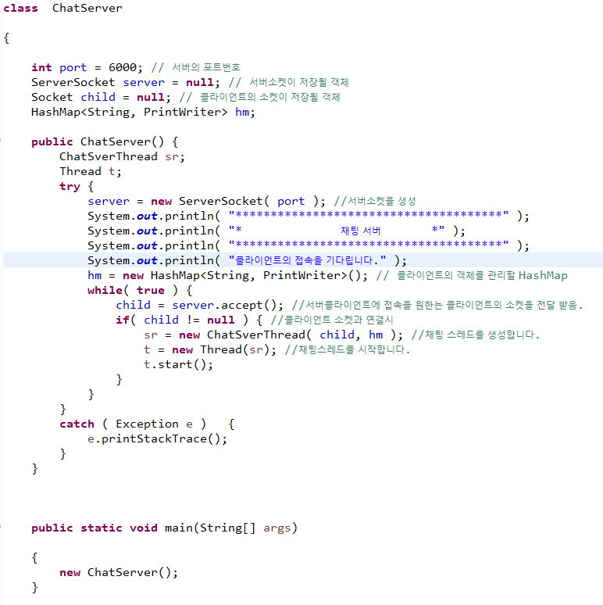
Multi-Chat Program
ChatServer

Slide 8
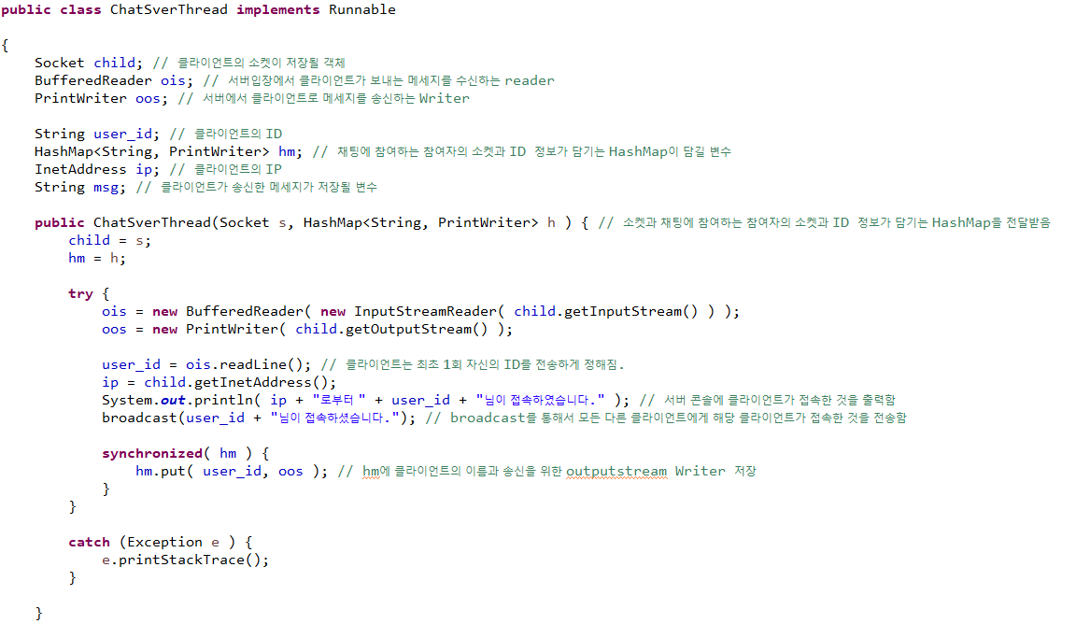
Multi-Chat Program
ChatSrverThread

Slide 9
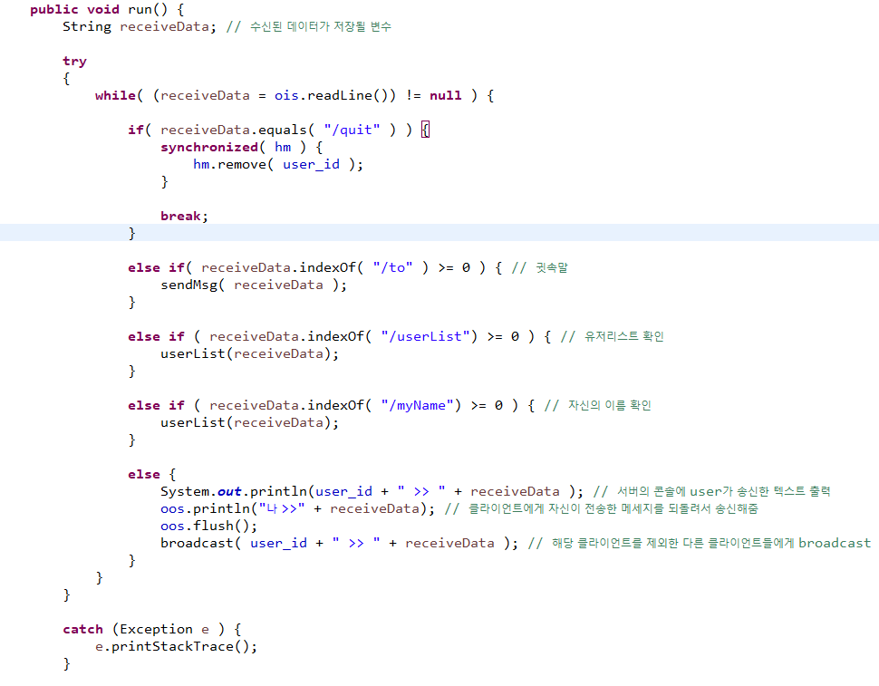
Multi-Chat Program
ChatSrverThread

Slide 10
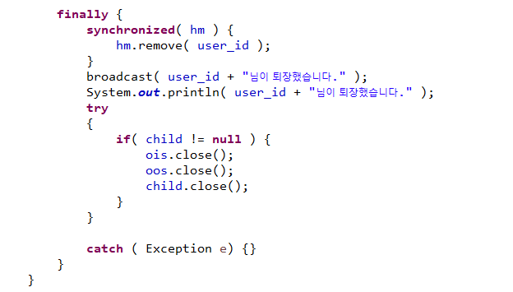
Multi-Chat Program
ChatSrverThread

Slide 11
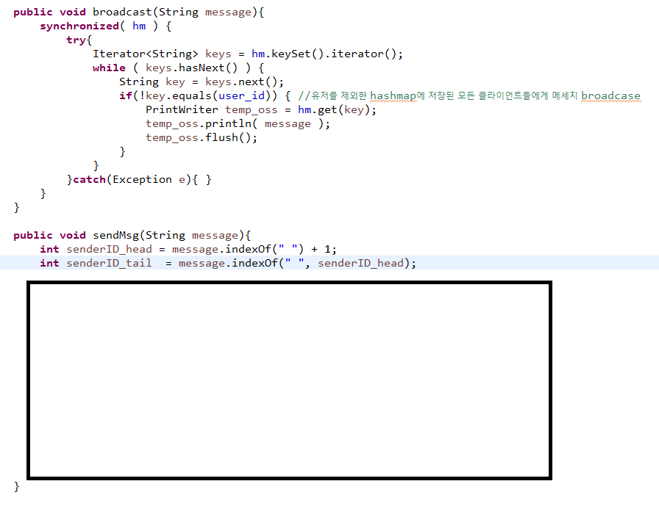
Multi-Chat Program
ChatSrverThread

Slide 12
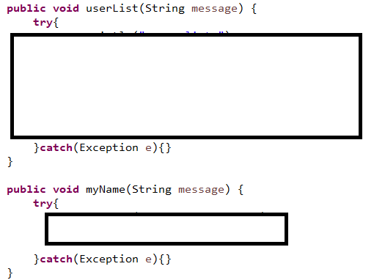
Multi-Chat Program
ChatSrverThread

